Slide 1
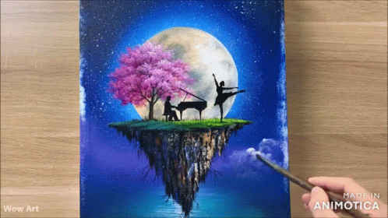
Famous paintings Analysis
BY:Ankita Bugga ,
Chaitali Pandharpure

Slide 2
INDEX
Importing Libraries
Database connectivity
Fetch Data from Database
Data Cleaning
Data View
Data Visualization
Conclusion

Slide 3
Problem Statement:
The art world, particularly in galleries, museums, and online art markets, often deals with large datasets that involve artists, artworks, museums, and pricing. To gain insights into trends in the art market, it is essential to organize and analyze this data effectively. The goal is to gather information on famous paintings, their artists, the museums where they are exhibited, and pricing information for potential buyers. A structured analysis of these datasets will allow for better understanding of artist productivity, museum collections, artwork pricing, and market trends, facilitating better decision-making for curators, collectors, and sellers.

Slide 4
Introduction
The Famous Paintings Analysis project aims to explore and analyze data related to renowned artworks, their creators, and the institutions that house them. By organizing information about artists, museums, canvas sizes, subjects, and pricing, this project provides insights into trends in the art world. The analysis not only highlights the contributions of various artists but also helps understand the relationship between artwork characteristics and their market value.

Slide 5
Objectives
· Data Integration:
· Import and integrate data from various tables related to artists, museums, canvas sizes, artworks, subjects, and pricing.
Create a cohesive dataset by merging tables based on relationships (e.g., artists, works, museum exhibits).
· Artworks and Artists Analysis:
Analyze the number of artworks by each artist and determine the top 10 most prolific artists.
Evaluate the distribution of artworks across different museums and cities.
· Pricing Analysis:
Investigate the relationship between artwork size (canvas size) and its pricing.
Calculate the average sale price and regular price based on canvas size and create visualizations of the price distribution.

Slide 6
Methodology
The project will follow a structured approach:
Data Collection: The dataset will be sourced from a kaggle website.
Data Preprocessing:
Handle missing data using imputation techniques.
standardize the data if necessary.
Exploratory Data Analysis (EDA):
Use descriptive statistics to summarize the dataset.
Create visualizations like histograms, bar char and pie chart to understand feature distributions and relationships.
Visualization:
Generate charts and graphs to visualize the findings.
Reporting:

Slide 7
Scope of Work
The project will involve the following tasks:
Data Exploration: Understanding the dataset, including the features and target variable.
Data Preprocessing: Cleaning the dataset by handling missing values, removing outliers, and normalizing/standardizing the data.
Feature Selection: Identifying the most significant features influencing mobile price range.
Data Visualization: Using plots and graphs to visualize the relationship between features and Famous paintings Analysis .

Slide 8

Importing Libraries
# Import required libraries
import mysql.connector # For connecting to MySQL
import pandas as pd # For data manipulation and analysis
import matplotlib.pyplot as plt # For data visualization

Slide 9

Database connectivity
# Establish a connection to the MySQL database
connection=mysql.connector.connect(
user='root',
password='security',
host='localhost',
database='famous_paintings'
)

Slide 10
Fetch Data from Database
# Fetch data from the 'artist' table
artist_data = fetch_data("SELECT * FROM artist", cursor)
print(artist_data)
# Fetch data from the 'canvas_size' table
canvasize_data = fetch_data("SELECT * FROM canvas_size", cursor)
print (canvasize_data)

Slide 11

Data Cleaning
Step 1 :Check Missing values: We can can check missing values
# Checking for missing values in artist_data
missing_values = artist_data.isnull().sum()
Step 2: Handling Duplicates :
duplicates = data.duplicated().sum()

Slide 12

Data View
Display basic information : print(data.info())
First few rows of the dataset: print(data.head())
To print the column names present in the dataset : data.columns
Check the shape of the DataFrame to understand its dimensions:print(data.shape)

Slide 13
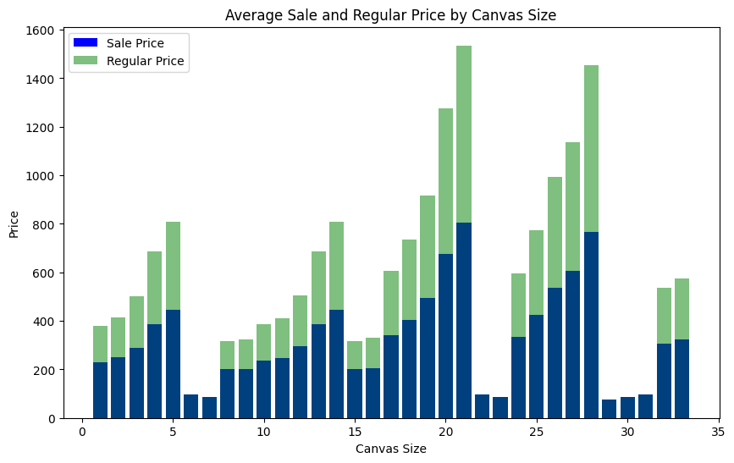
Data Visualization
# Average Sale and Regular Price by Canvas Size

Slide 14
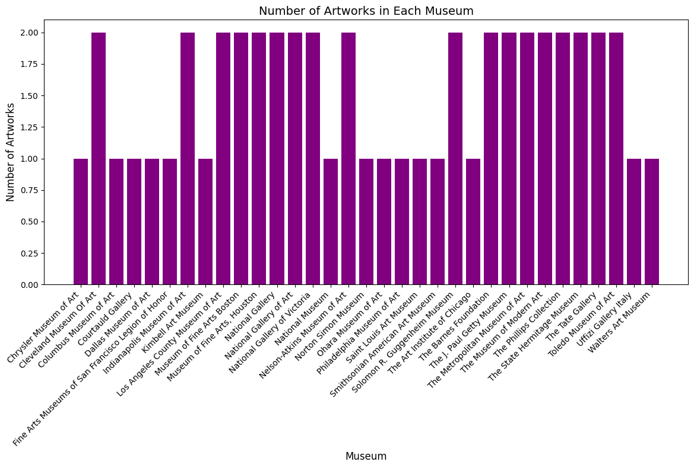
# Number of Artworks in Each Museum

Slide 15
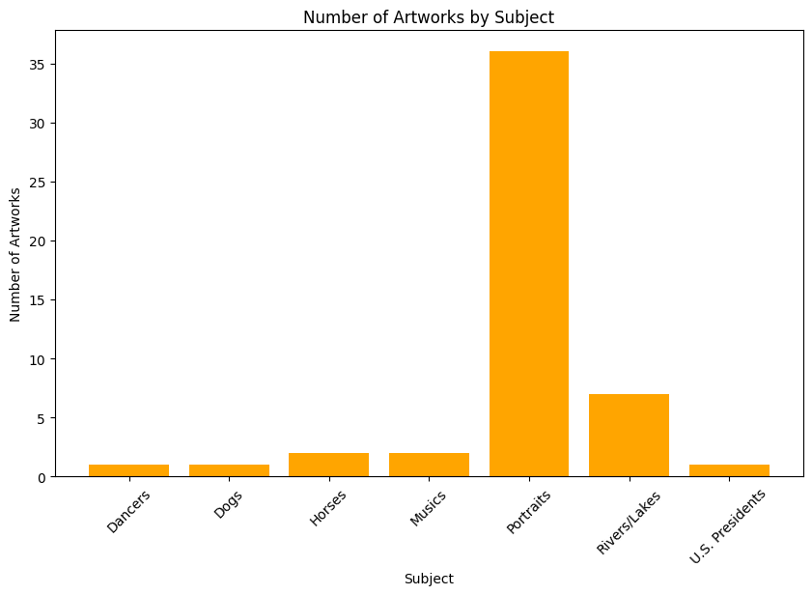
# Number of Artworks by Subject

Slide 16
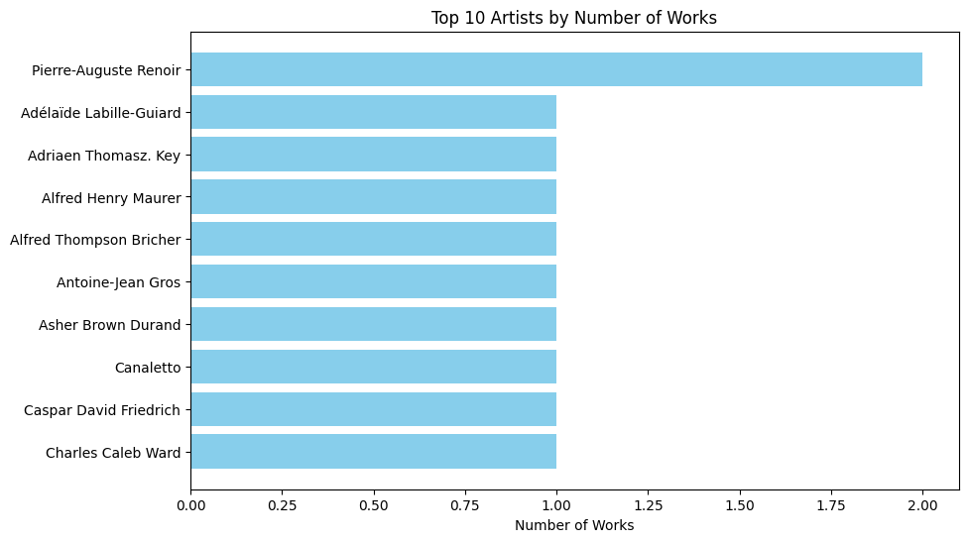
# Top 10 Artists by Number of Works

Slide 17
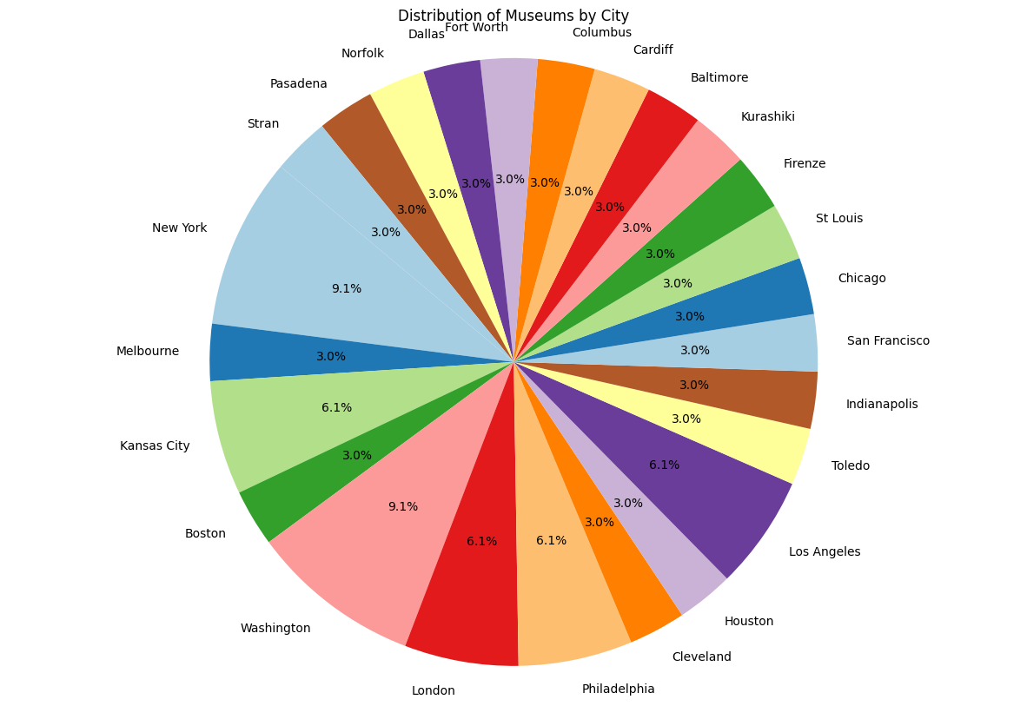
# Distribution of Museums by City

Slide 18
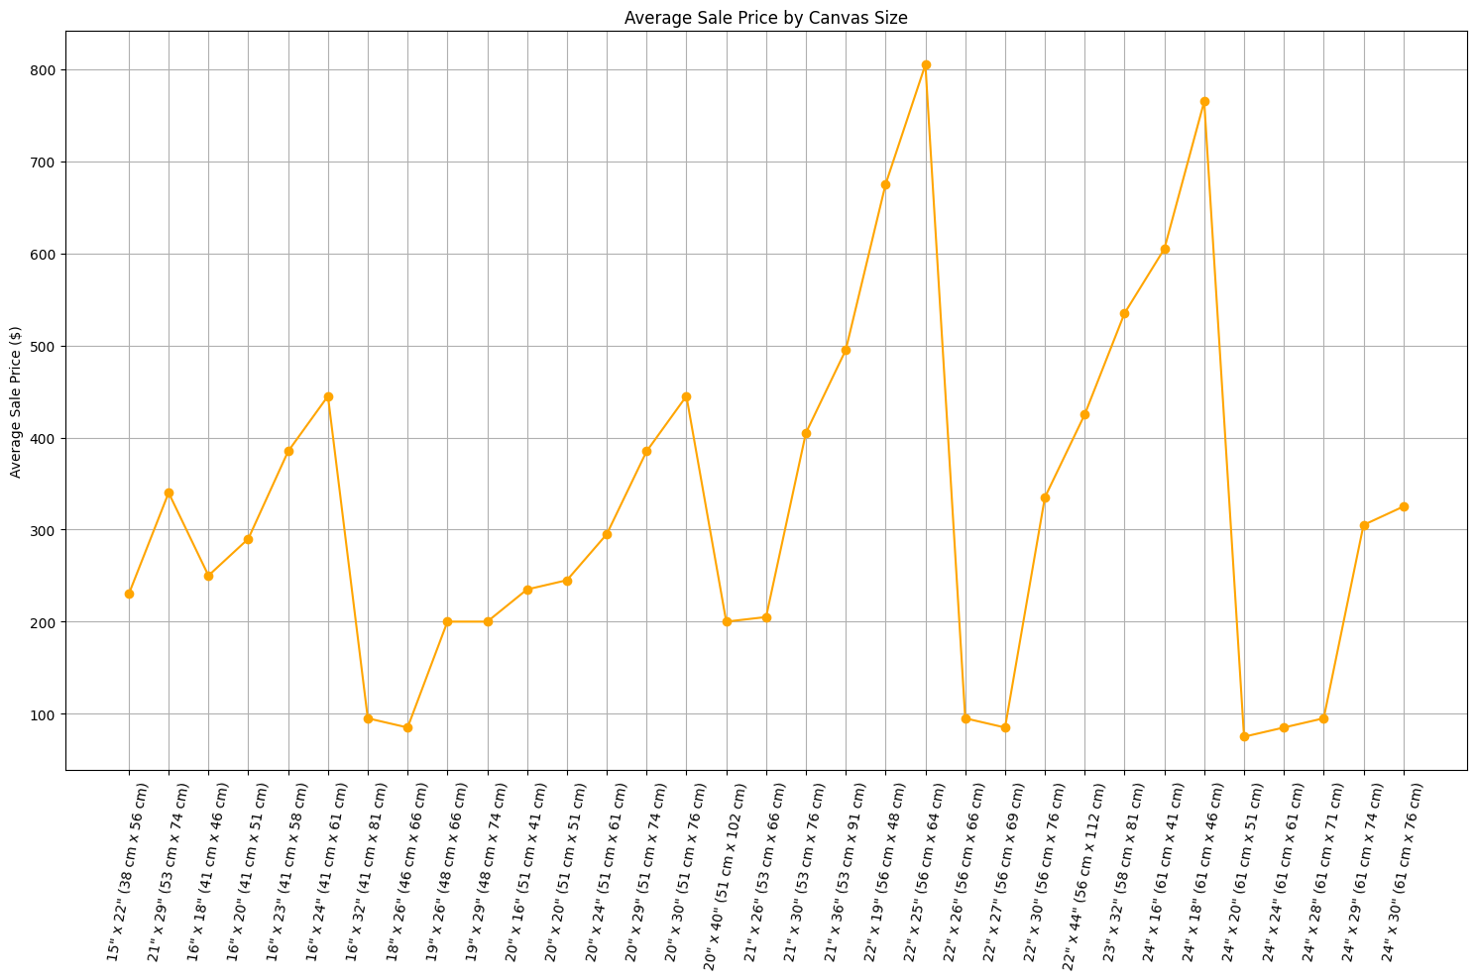
# Average Sale Price by Canvas Size

Slide 19
Methodology
The project will follow a structured approach:
Data Collection: The dataset will be sourced from a kaggle website.
Data Preprocessing:
Handle missing data using imputation techniques.
standardize the data if necessary.
Exploratory Data Analysis (EDA):
Use descriptive statistics to summarize the dataset.
Create visualizations like histograms, bar char and pie chart to understand feature distributions and relationships.
Visualization:
Generate charts and graphs to visualize the findings.
Reporting:

Slide 20
Tools and Technologies
The project will utilize the following tools and technologies:
Programming Language: Python,mysql.
Libraries: Pandas, NumPy, Matplotlib,mysql.
IDE: Jupyter Notebook or any Python-compatible Integrated Development Environment (IDE)
Data Source: kaggle website (Famous paintings Analysis)

Slide 21
Expected Outcomes
Identification of the most significant factors influencing Famous paintings Analysis .
Visualization of the data and model results to provide actionable insights for paintings industry.
A comprehensive report documenting the analysis process, findings, and recommendations.

Slide 22
Timeline
The project is expected to be completed within a [specific timeframe, e.g., 4 weeks], with the following milestones:
Week 1: Data Collection and Preprocessing
Week 2: Exploratory Data Analysis and Feature Selection
Week 3: Evaluation
Week 4: Visualization, Reporting, and Final Submission

Slide 23
Conclusion
In conclusion, this project offers a comprehensive view of famous paintings and their surrounding context. By examining data on artists, museums, and pricing, we gain valuable insights that can aid collectors, curators, and art enthusiasts in making informed decisions. The visualizations generated from the analysis further enhance understanding, making it easier to identify trends and patterns in the art market. This study underscores the importance of data in appreciating and valuing artistic creations.

